Slide 1
Enter at Your Own Risk
Taking the Risk Out of Re-Entry
Notes:
Hello, everyone!
Thank you for the opportunity to share my experiences with you.
Business Continuity and Recovery Planner with the Calgary Emergency Management Agency – during this time I have worked in our City of Calgary Emergency Operations Centre for condo fires, events such as Calgary Stampede Parade, Grey Cup, municipal elections and deployed to Fort MacMurray to support the fire response and re-entry. Currently conducting planning for mobile vaccination sites within the City of Calgary
Volunteer with Team Rubicon – part of the Incident Management Team deployed to Kamloops to support Lytton BC
Recently taken on a role as an advisor to the Northern Alberta Institute of Technology Program Advisory Committee for the Emergency Management Diploma

Slide 2
WHAT WE WILL COVER
Why Talk About Re-Entry?
Re-Entry Criteria
Two Case Studies:
COVID-19
Wildfires
Notes:
We will start off by talking about why it is important to discuss re-entry. It often gets lumped in as part of recovery but as we go through the two examples you will see that re-entry does not always correlate with recovery.
We will discuss the criteria that needs to be considered when planning for and implementing re-entry strategies.
Then we will look at two different incidents that have required re-entry planning– COVID and wildfires.

Slide 3
WHY TALK ABOUT RE-ENTRY?
According to United Nations Food and Agricultural Organization (FAO), disasters happen three times more often today, than in the 1970s and 1980s. Are you planning for a cycle of evacuation and re-entry from the workplace and/or community?
People are evacuated for longer amounts of time from homes and businesses after a disaster. (Some people have not returned to their workplace since March 12, 2020, because of COVID-19. Some fire evacuees in B.C. have been out of their homes since July due to wildfires). What are the impacts that must be considered and planned for?
Planning has focused on response (getting people out) and recovery (what do we do when we are back) but where is the planning to get people back into work and/or back into their community?
Notes:
According to the United Nations Food and Agriculture Organization, disasters happen three times more often today, than in the 1970s and 1980s. Something else to consider is that communities that are evacuated due to incidents such as wildfires are sometimes allowed to re-enter their community only to be evacuated yet again. Part of re-entry planning is having a re-exit strategy.
People are being evacuated for longer amounts of time. Previous planning around people being evacuated for three to seven days (a length of time often heard when telling people to put together to go kits) is no longer sufficient. When people are evacuated for months at a time things such as re-routing postal service, shutting off utilities, security of the area, residences and businesses, and starting the school year have to be considered and then re-evaluated as people start to re-enter the community.
Planning has focused on mitigation, preparedness, response and recovery. Business continuity planning has helped to highlight the need to maintain essential services and help small businesses plan for disasters. Some of the concepts, such as prioritization of services and contingency planning can help with re-entry planning

Slide 4
RE-ENTRY CRITERIA
WHAT TO CONSIDER TO GET BACK IN
PEOPLE
RECORDS
People will be one of the most critical elements and potentially the most complicated (depending on the event). Identify your audiences.
Identify what records have been affected and what must be in place, especially from a safety and legal perspective.
FUNCTIONS
FACILITIES
Identify the functions, services and programs that must be implemented before deploying back to primary facilities or moving to temporary or new facilities.
Determine the condition of facilities after the event. Performing a detailed damage assessment may require information from a structural engineer or other similar experts.
COMMUNICATIONS
Clear guidance and frequent communications will be critical to minimizing concerns during a very high stress period.
Notes:
I am going to describe the general criteria for re-entry then use two examples, COVID and wildfires to show how they are applied.
One of the first considerations and the most important is:
People
Identify your audience (who is your messaging, education and awareness targeting) – public, staff, clients, Mayor/Council, CAO, Senior Management, etc.
Identify their needs – remember Maslow’s hierarchy of needs? Physiological and safety needs have to be addressed before people can move on to love and belonging, esteem and self-actualization. We need to empower people but before that can happen their most basic needs for shelter, water, food, warmth, rest and health have to be taken care of.
Plan to address those needs – most often realized through Emergency Social Services in the community in partnership with non-government organizations
Functions
What programs, services are essential?
What must be in place before a safe return to work or the community?
Returning hundreds or thousands of people to a community requires planning to ensure that shelter food, pharmacy, banking, postal services are available – that is the services that support the needs
Communications
Clear policy guidance and frequent communications with all the public/staff will be critical to minimizing concerns during a very high stress period. The potential for concern about these issues should not be underestimated.
Use a variety of platforms to reach the greatest number of people
Create clear, consistent messaging working with stakeholders so that all partners are delivering the same messages
Facilities
A key step in planning is to determine the condition of facilities after an event.
A rapid damage assessment may be performed to determine the general condition of facilities.
A detailed damage assessment requires information from a structural engineer or other similar experts.
Critical Infrastructure, e.g., bridges, utilities needs to be inspected.
Depending upon the type and severity of the incident, temporary housing may have to be found or in the case of office space in COVID, staff may need to be accommodated.as staff return to the office, will cubicles suffice? Will new floor plans need to be created?
Records
Identify records affected by the incident.
Transition or recover essential records and databases.
Depending upon the extent of damage or loss, some records may have to be re-developed. Any safety or legal records should be prioritized, e.g., safety procedures, bylaws, etc.

Slide 5
CASE STUDY 1: COVID-19
WHAT TO CONSIDER TO GET BACK IN
FUNCTIONS
FACILITIES
Phased re-entry of essential functions. IT support. Training. Identification of public services and programs.
Office/cubicle assignment. Facility capacity for meeting rooms, eating areas, gyms, common areas.
1
2
3
4
5
PEOPLE
COMMUNICATIONS
RECORDS
Determine who, when and how staff return to workplace, continuing health measures, mental health supports, supervisor toolkit.
Create communications plans for staff, the public, clients/customers. Consistently communicate.
Documentation for tracking movement of people in the event of contact tracing. Movement of documents between home and work.
Notes:
Approximately a third of City staff, up to 5,000 people, have been working from home since March 2020. The City of Calgary has had to move the target date of re-entry back three times. Originally staff were to return to the office in September, then October and now it is January 3rd.
Safety Advisors, Human Resources, Customer Service and Communications and Business Continuity Coordinators have been working with the Corporate Rapid Response Team (including IT, Security, Facilities Management, Environmental and Safety Management) to develop procedures, re-entry and re-exit plans.
People
Though re-entry strategies are focused on those staff returning to work, consideration also should be given to those that have remained working in the office to support and to front line workers. They have remained, working with COVID protocols, working front counters, being in the public. Having staff return to the office will disrupt office patterns that have emerged over the last 18 months.
In Calgary, business units are being encouraged to work together with their leadership team and Business Continuity Coordinator to determine what they need to implement the Corporate standards and criteria in their respective areas.
Determine who, when and how staff will return to the workplace.
We started this process twice now, going into a third– with some initial processes and plans developed, communicated to staff only for COVID cases to go up and conditions worsen – some staff went back to work only to be sent home again.
Continually check-in with your staff to ensure that concerns are heard, understood and addressed. Resources including re-boarding and orientation packages have been developed and online tools and courses
Functions
Return of IT equipment to work will be one of the biggest functions affected.
Corporate IT will be refining the deployment plan on how to assist staff to reconnect their equipment in the corporate workspace. They have provided a survey to staff to determine their IT support needs and are providing the option to hook up your own equipment when you get back to the office or make an appointment to have IT provide the service.
Communications
Staff: Town Halls with City Manager, Chief of Calgary Emergency Management Agency, Facilities, Environmental Safety Management, email updates from City Manager
MANAGE EXPECTATIONS –talk more on the next slide about this
Facilities
Indoor Air quality has been improved via increase in fresh air intake volumes and increase in filtration rates.
Janitorial cleaning will continue for high-touch areas
Covid mitigations will gradually reduce as occupancy increases depending upon the Business Unit. Some office areas may see one way travel removed, while queuing markers may remain at public facing counters.
Monitoring and online reporting of COVID illnesses, clusters, and outbreaks will continue.
Corporate security will ensure building access is available for staff accordingly and will remain a visible presence in facilities.
Records
COVID has not had a huge impact in the way of loss of records but has changed how we manage records.
Moving to more file sharing on Microsoft Teams
Many procedures, protocols, even bylaws and orders developed and implemented. What are we going to do with all of it? Do not want to lose it – Y2K good example
Consideration moving forward is going to include what will we continue with in the way of processes.

Slide 6
The Key is Transparency
Consistently communicate – even if you don’t have a clear answer keep staff up to date with what you do know.
Allow for transition - when able, accommodate staff, e.g., there may be childcare or care for elderly parents that staff must arrange for.
Acknowledge efforts by saying thank-you – simple, timely recognition goes a long way.
Manage employee expectations whenever possible.
Explain the why’s behind our ‘new normal’ (such as signage, cleaning protocols, distancing).
Take a few minutes to check in with your team members, share information
Notes:
Be as transparent as possible, even if decisions aren't final. One way is to give a general time frame of return.
Employees want to understand the rationale for decisions. And they also understand that the situation is really fluid. If leaders could be authentic about that, and communicate that in a clear and consistent way, that goes a long way with employees.“
Consistently communicate – even if you don’t have a clear answer keep staff up to date with what you do know.
Allow for transition - when able, accommodate staff, e.g., there may be childcare or care for elderly parents that staff must arrange for. Not every aspect of people’s lives will be lining up to return to pre-COVID times.
Acknowledge efforts by saying thank-you – simple, timely recognition goes a long way.
Manage employee expectations whenever possible.
Explain the why’s behind our ‘new normal’ (such as signage, cleaning protocols, distancing).
Take a few minutes to check in with your team members, share information .

Slide 7
CASE STUDY 2: WILDFIRES
WHAT TO CONSIDER TO GET BACK IN
FUNCTIONS
FACILITIES
Ash sampling. Drinking water. Surface water monitoring. Air quality. Power. Emergency services. Hazard removal. Fire threat. Garbage, waste, debris removal.
Transportation routes accessible and critical infrastructure secured. Rapid damage assessment.
1
2
3
4
5
PEOPLE
COMMUNICATIONS
RECORDS
Psycho-social supports. Access to transitional housing. Public access to food, pharmaceuticals.
Public communications. Controlled resident tour, controlled media tour.
Electoral lists available. Bylaws. Policies. Access and egress tracking.
Notes:
In July I deployed for a week to work in the Lytton EOC that was based in Kamloops. Just after I left, some people were allowed back in, but most residents lost their homes. Lytton First Nation and some residents of the Thompson Nicola Regional District were also evacuated.
People
Accountability needs to established for people coming into the community. A Resiliency Centre where they could sign in, get information, clean up kits, information on supports while they were there, e.g., porta-potties. Other information regarding health and safety; contact information for insurance providers, mental health supports, government programs, utility companies; was also provided.
Identify residents whose homes are damaged and notify them of the loss prior to re-entry. Residents’ first notice that their home was damaged or destroyed should not be on site. Mental health supports and traditional and cultural health supports can be made available and supported through FNHA. Disaster psychosocial information is important for the community but also for anyone involved in the emergency response efforts.
First Nations self-determine the process for re-entry and the timelines for re-entry are occasionally different than for a local authority. Understanding the cultural dynamics within a community, and differences in protocol amongst communities, is critical. Consulting with Chief and Council, as well as identified community Elders and respected leaders, to determine communities’ unique cultural and traditional needs (e.g., traditional healing ceremonies, drum circles) during the re-entry process and involving them in the development of re-entry plans, drawing upon their knowledge and leadership skills;
Functions
A number of services and functions have had to be assessed including:
Hazardous
Air quality
Drinking water
Soil quality
Hazardous materials identified and mitigated;
A Post-wildfire assessment had to be conducted
Fire, police, EMS and 911 and services available;
Communications
Provide regular updates to residents in order to dispel rumours, enhance safety, promote transparency and trust,
Controlled resident tour of affected areas,
Public communications regarding the testing and assessments that have to be completed before re-entry can be provided
Facilities
Damage assessments of residences and critical infrastructure such as the water treatment facility
Coordinate with other local authorities, First Nations and RCMP if re-entry routes run through other jurisdictions under an evacuation order to ensure security is in place and that routes are not overwhelmed by multiple re-entries at the same time;
Ensures transportation arrangements are made for residents who do not have their own means to return to the community.
Records
Tracking of expenses for Disaster Financial Assistance is essential for getting money back for response and recovery expenses through provincial and federal governments
State of Local Emergency, including renewals and cancellations have to be filed with the provincial government. Evacuation orders also have to be filed.
Tracking of Access and egress from area (security concerns, safety) needs to be implemented

Slide 8
CASE STUDY: WILDFIRES
Communicate with the public on the steps that must take place before a safe re-entry can take place.
Communicate with the public while the re-entry is taking place. Keep them informed of changes – and there will be changes!
Communicate with the public after re-entry has taken place. Get their feedback. What worked, what did not, what needs improvement.
Notes:
People are not aware of all the boxes that must be checked to get them back home safely so that they can start the recovery process.
It can take weeks to months to get all the soil, water, air testing done and results back – especially in a really busy fire season that impacts multiple communities.
Educate the public, elected officials and partners on what must be considered, planned for and implemented.
Involved trusted officials in the communication process. Use Townhalls – during the Fort Mac Fire, townhalls could be held by the Mayor in person in different communities.During COVID we discussed holding them on Facebook. The presentation itself could even be recorded and then provide a live Q and A. COVID has opened up a whole new way of communicating which can be helpful when you have a community scattered around a province and beyond.
Be transparent about timelines, setbacks and celebrate the successes.

Slide 9
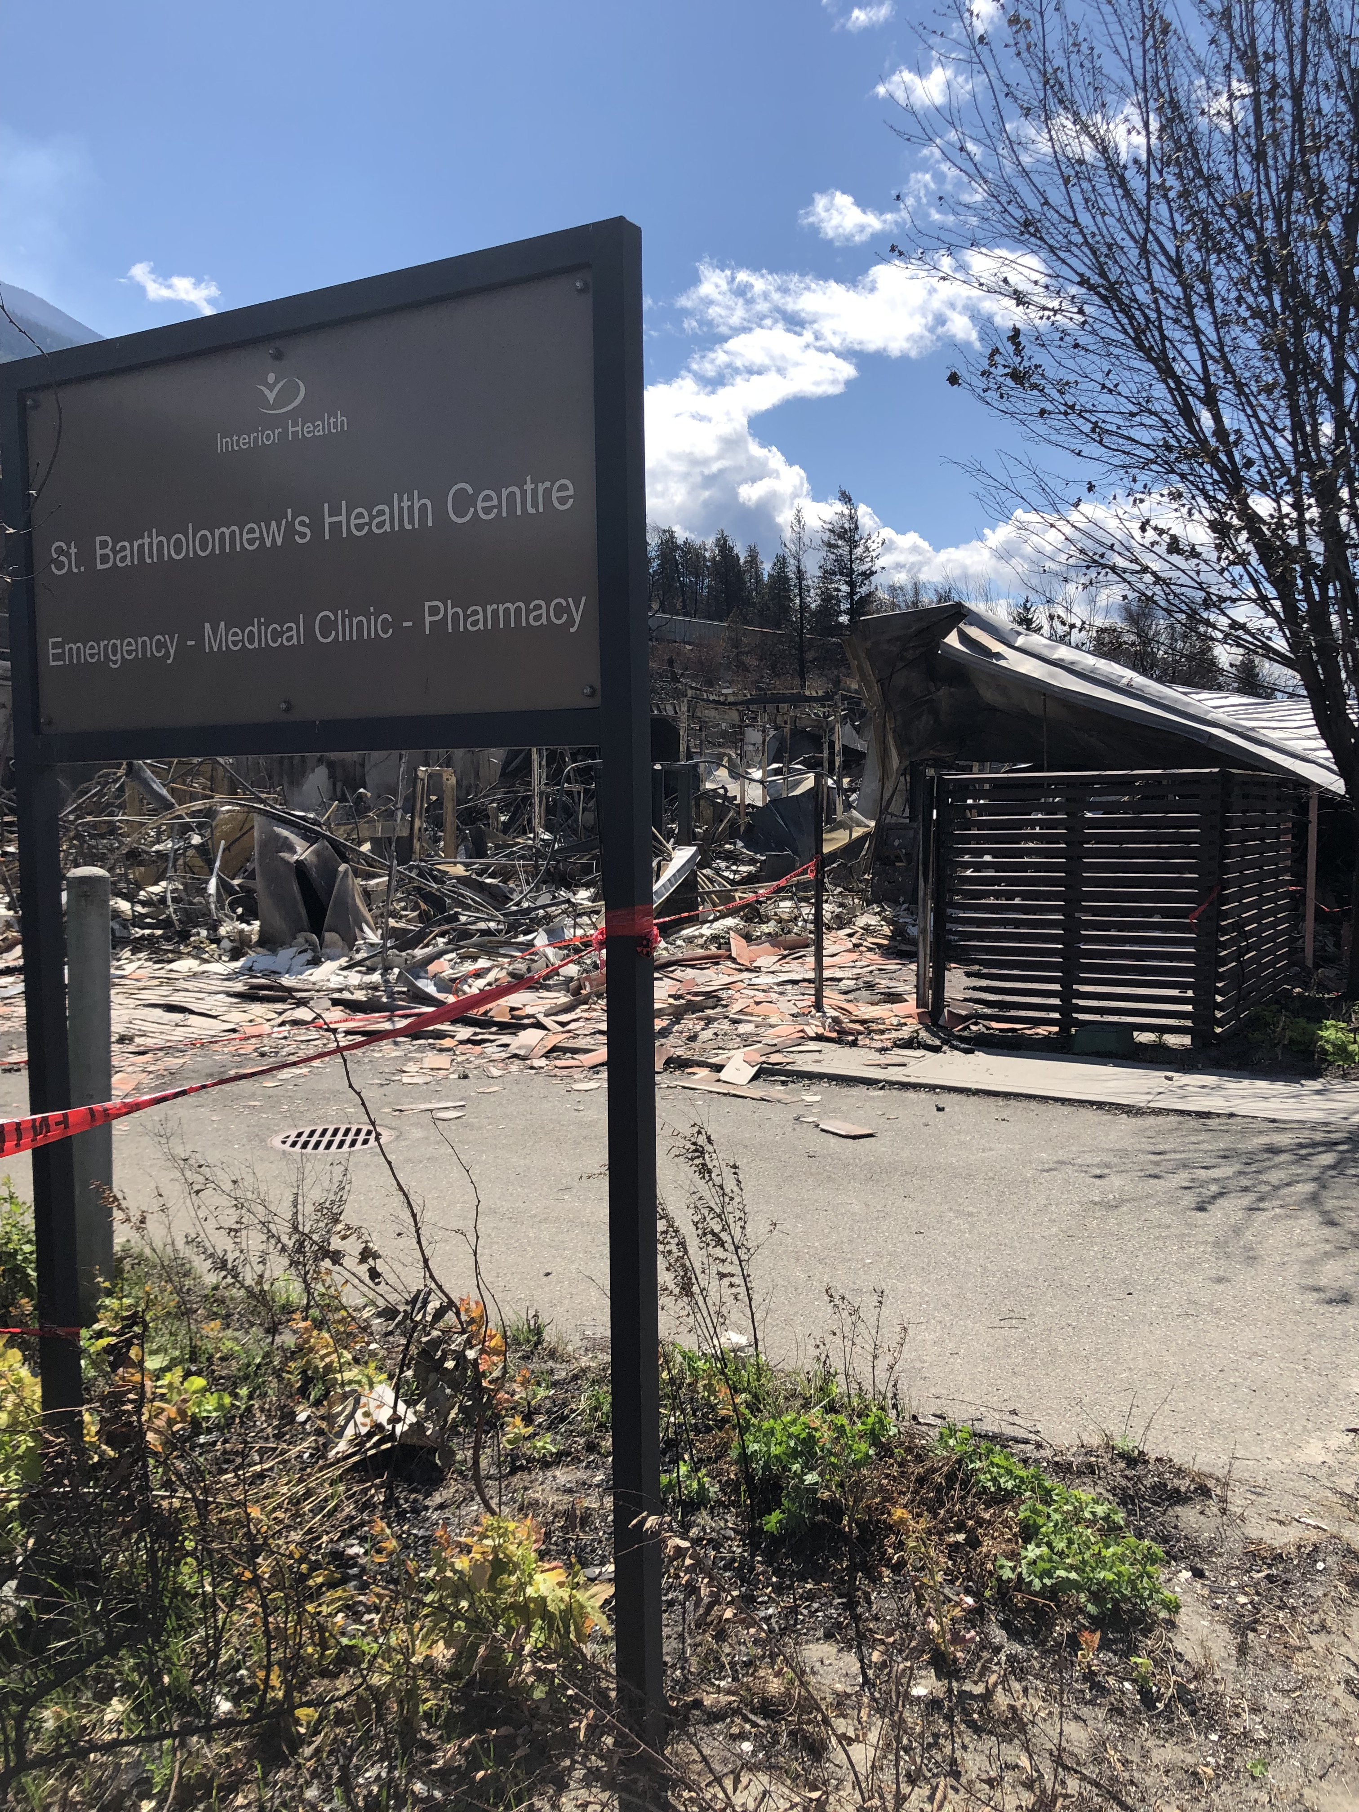
QUESTIONS?

Slide 10
THANK
YOU
THANK YOU!
GET IN TOUCH
Joanne Auclair
joanne.auclair@calgary.ca

